Slide 1

Game Playing
Part – 2

Slide 2
Nim Game Problem
There is a single pile of matchsticks (>1) and two players
Moves are made by the player alternately
In each move, each player can pick up a maximum of half the number of matchsticks in the pile.
Whoever picks the last matchstick loses.

Slide 3
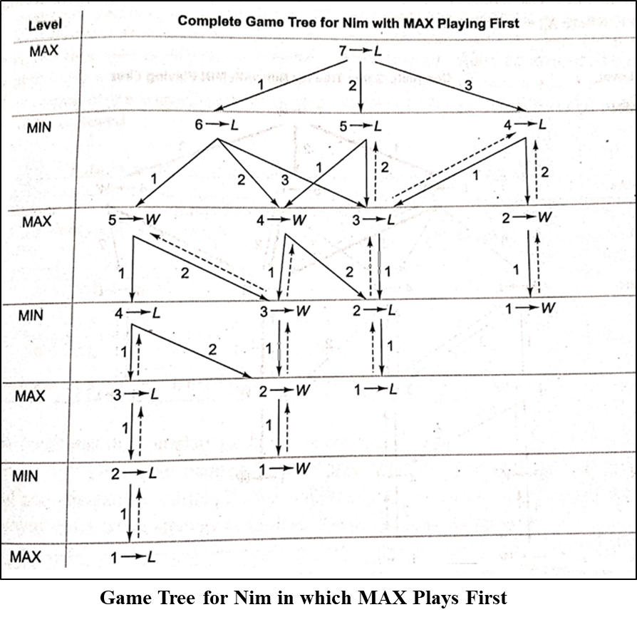
Nim Game Problem
Mark status of terminal
Mark the status of non terminal by using status labelling procedure
Root (MAX→L)
MIN always wins irrespective of the move made by the first player

Slide 4
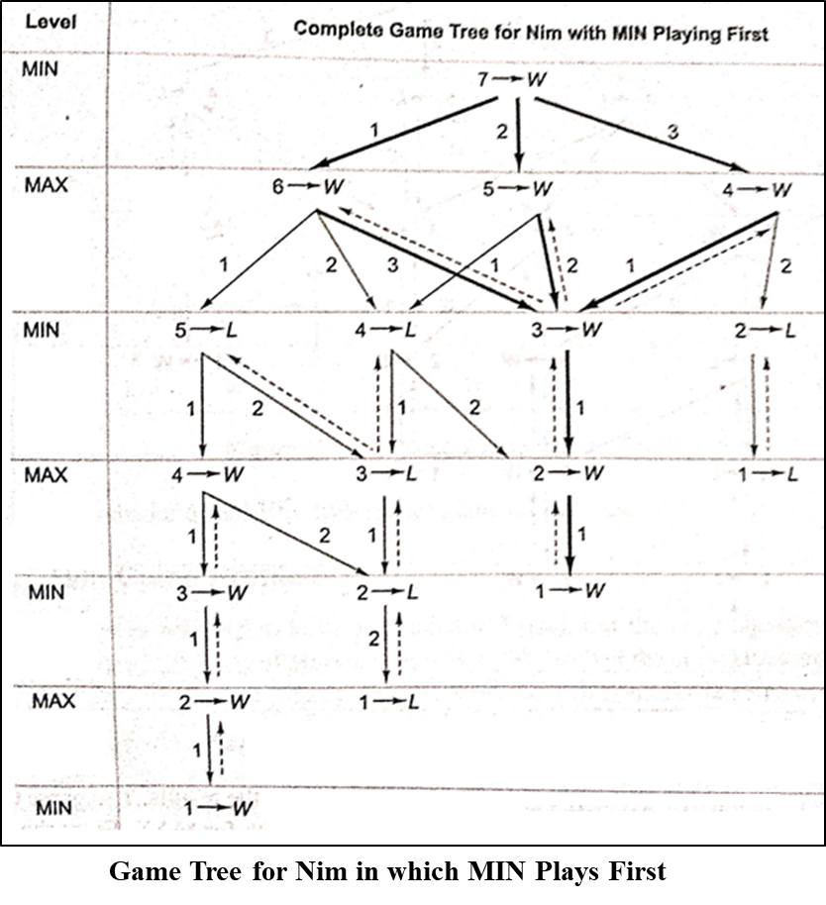
Nim Game Problem
Mark status of terminal
Mark the status of non terminal by using status labelling procedure
Root (MIN→W)
MIN always wins irrespective of the move made by the first player

Slide 5
Strategy
If at the time of MAX player’s turn there are N matchsticks in a pile ,
then Max can force a win by leaving M matchsticks for the MIN player to play , where
M ∈ {1,3,7,15,31,63,…}
using the rule of game (that is MAX can pick up a maximum of half the number of matchsticks in the pile).
The sequence {1,3,7,15,31,63,…} can be generated using the formula
X_{i} = 2 X_{i-1} + 1 for i >0 where X₀ =1

Slide 6
Strategy
First method
Look up from the sequence {1,3,7,15,31,63,…} and figure out the closest number less than the given number N of match sticks in the pile .
The difference between N and the number gives the desired number of sticks that have to be picked up .
For example , if N=45,the closest number to 45 in the sequence is 31, so we obtain the desired number of matchsticks to be picked up as 14 on subtracting 31 from 45.
This way try to maintain a sequence {1,3,7,15,31,63,…}.
Second method
the desired number is obtained by removing the most significant digit from the binary representation of N and adding it to the least significant digit position.
N | Binary Representation | Sum of 1 with MSD removed from N | Number of sticks to be removed | Number left in pile
13 | 1101 | 0101+0001 | 0110=6 | 7
27 | 11011 | 01011+00001 | 01100=12 | 15
36 | 100100 | 000100+000001 | 000101=5 | 31
70 | 1000110 | 0000110+0000001 | 0000111=7 | 63

Slide 7
MAX - WIN
We can formulate two cases where MAX will always win if the following strategy is applied.
CASE 1 MAX is the first player and initially there are
N ∉ {3,7,15,31,63,…} matchsticks.
CASE 2 MAX is the second player and initially there are
N ∈ {3,7,15,31,63,…} matchsticks.

Slide 8
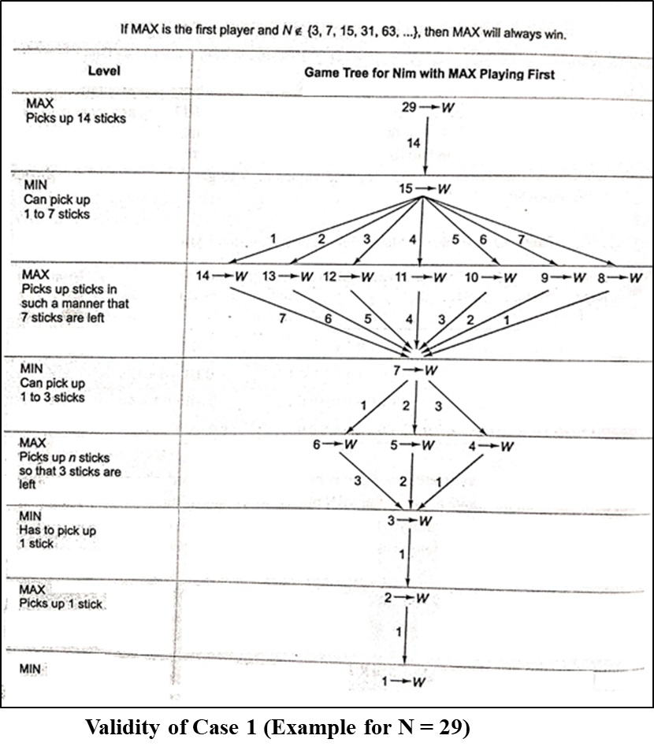
Validity of Cases for Winning of MAX Player
CASE 1 If MAX is the first player and
N ∉ {3,7,15,31,63,…}.
MAX will always win.
Consider a pile of 29 sticks and let MAX be the first player.

Slide 9
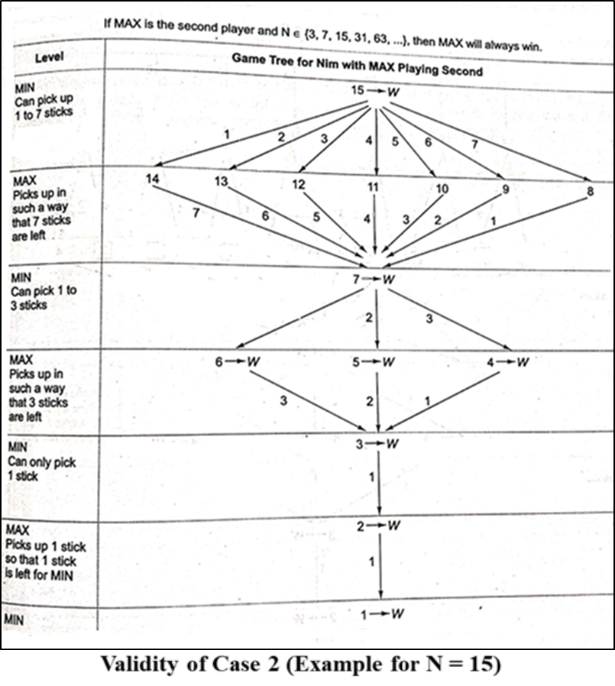
Validity of Cases for Winning of MAX Player
CASE 2 If MAX is the second player and
N ∈ {3,7,15,31,63,…}
Consider a pile of 15 sticks and let MAX be the second player.
The complete game tree for this case is shown in fig.

Slide 10
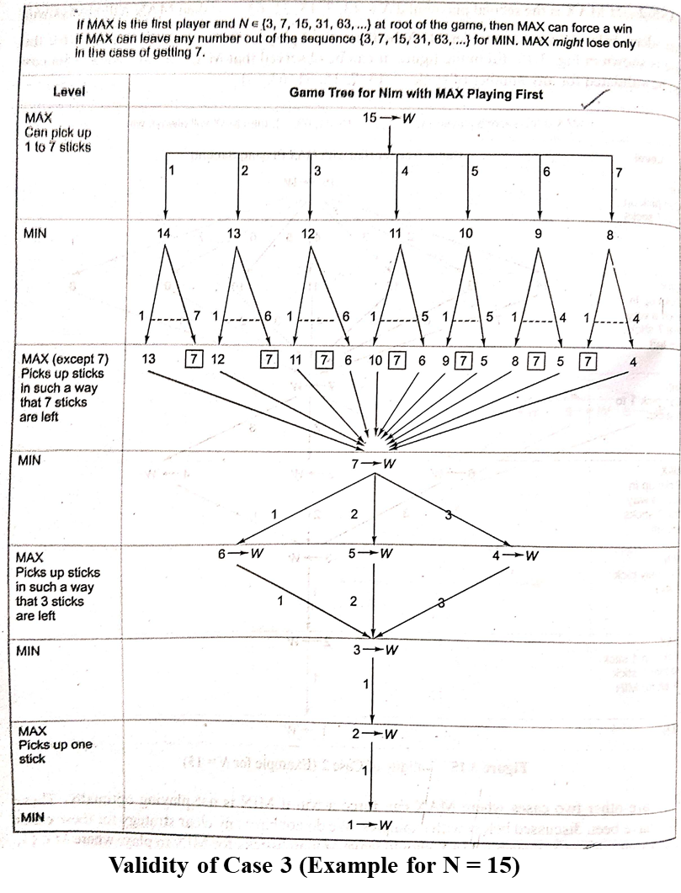
Validity of Cases for Winning of MAX Player
CASE 3 If MAX is the first player and N ∈ {3,7,15,31,63,…} at root of the game,
MAX can force a win using the strategy mentioned above in all cases except when MAX gets a number from the sequence {3,7,15,31,63,…} at its turn.
Assume that N=15 fig 1 shows that MAX wins in all cases except when it gets 7 matchsticks in its turn.
MAX can even win the game when it gets 7 sticks at its turn in the game for all values except when it gets 3 sticks at its turn in the game.

Slide 11
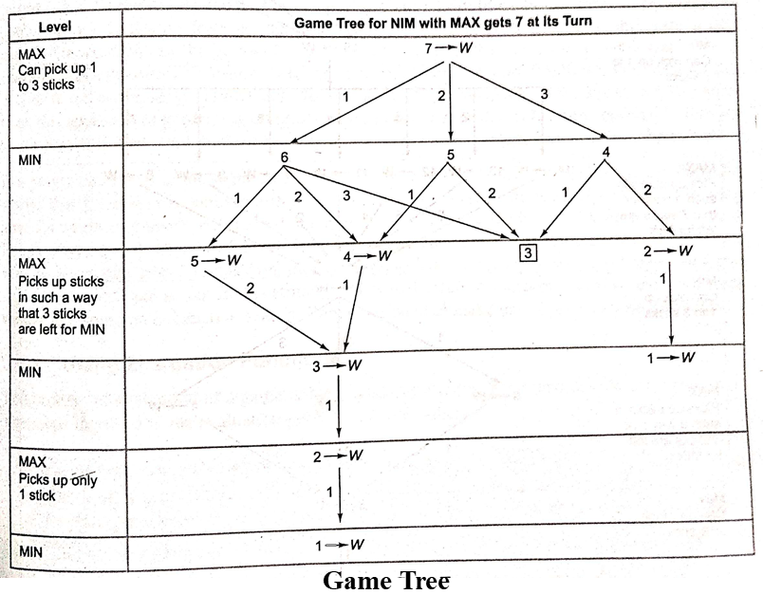
Validity of Cases for Winning of MAX Player
MAX can even win the game when it gets 7 sticks at its turn in the game for all values except when it gets 3 sticks at its turn in the game.

Slide 12
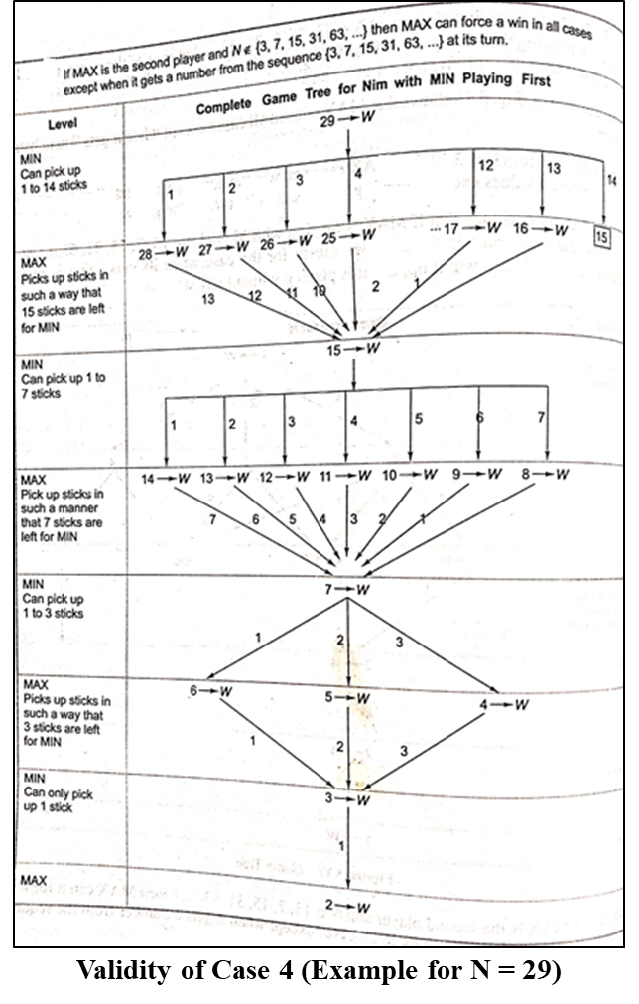
Validity of Cases for Winning of MAX Player
CASE 4 If MAX is the second player and N ∉ {3,7,15,31,63,…} then MAX can force a win using the above mentioned strategy in all cases except when it gets a number from the sequence {3,7,15,31,63,…} at its turn.
Let N=29
Let MIN be the first player.
MAX wins in all cases except when it gets 15 matchsticks at its turn.
Max might lose in case of it getting 15.

Slide 13
Bounded Look-Ahead Strategy and use of Evaluation Functions
Status labelling procedure requires the generation of complete tree or atleast some part of it
For many games in reality too large trees may be generated & need to be evaluated backward from terminal to root in order to determine the optimal first move.
This approach may not be practical
It is better to look for about few levels before deciding the move
Look-ahead strategy : The player can develop the game tree to some extent before deciding on the move.
N-move Look-ahead strategy : The player is looking ahead n no of levels before making a move.

Slide 14
Bounded Look-Ahead Strategy and use of Evaluation Functions
Using Evaluation Functions
The first step is to decide which features are of value in a particular game.
The next step is to provide each feature with a range of possible values.
The last step is to devise a set of weights in order to combine all the feature values into a single value.
Alternative is using heuristic approximation.
A proper static evaluation function can convert all judgments about board situations into a single overall quality number
Function provides numerical assessment which indicates the favorable condition for MAX.
+ve value ⇒ good and -ve value ⇒ bad for MAX.
The heuristic value of nodes are determined at some level (one-ply /two-ply).
The procedure through which the scoring information travels up the game is called MINIMAX procedure

Slide 15
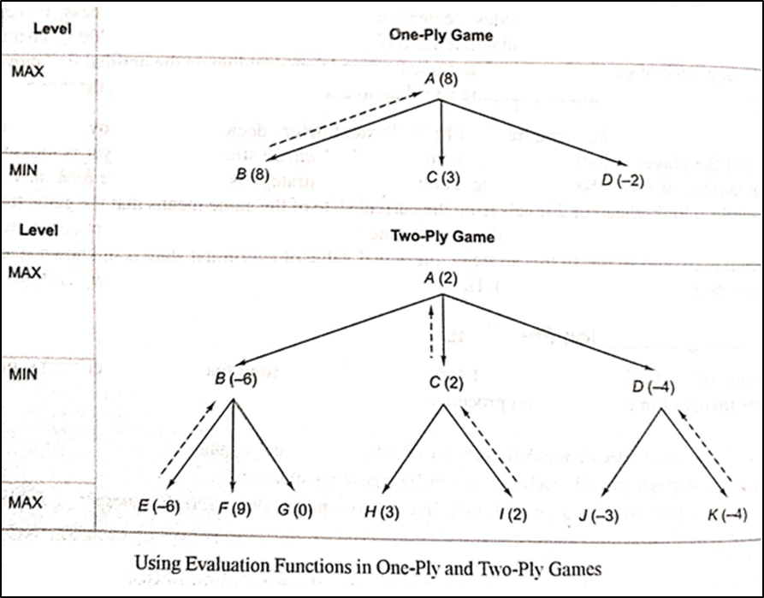
One-Ply & two-Ply

Slide 16
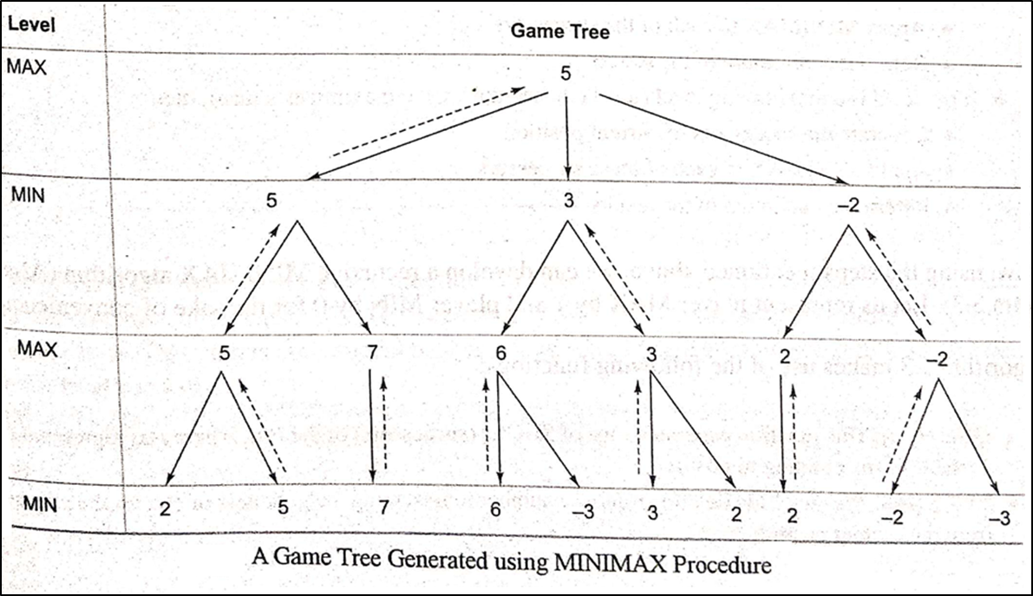
MINIMAX Procedure
It is the procedure through which the scoring info travels up the game tree.
Propagates to root, the estimated score generated by heuristic evaluation function.
It is recursive algorithm.
Player tries to maximize its chance of a win while minimizing that of the opponent.
A player with +ve number is maximizing player
A player with –ve number is minimizing player
A each move MAX player tries to take a path that leads to a large +ve number while opponent will try to face the game towards –ve static evaluation.

Slide 17
MINIMAX Procedure
The algorithmic steps of this procedure may be written as:
Keep on generating the search tree till the limit, say depth d of the tree, has been reached from the current position.
Compute the static value of the leaf nodes at depth d from the current position of the game tree using evaluation function.
Propagate the values till the current position based on MINIMAX strategy.

Slide 18
MINIMAX Strategy
Steps in MINIMAX strategy are written as follows:
If the level is minimizing level(level reached during minimizer’s turn),then
Generate the successors of the current position
Apply MINIMAX to each of the successors
Return the minimum of the results
If the level is maximizing level(level reached during maximizer’s turn),then
Generate the successors of the current position.
Apply MINIMAX to each of the successors
Return the maximum of the results

Slide 19
MINIMAX Algorithm
The functions used are:
GEN(Pos) : This function generates a list of SUCCs (successors) of the Pos , where Pos represents a variable corresponding to position.
EVAL(Pos, Player) : This function returns a number representing the goodness of Pos for the player from the current position.
DEPTH(Pos, Depth) : It is a Boolean Function that returns true if the search has reached the maximum depth fro the current position , else it return false.

Slide 20
MINIMAX Algorithm
MINIMAX(Pos, Depth, Player) {
If DEPTH(Pos, Depth) then
return ( { Val=EVAL(Pos, Player), Path= Nil } )
Else {
SUCC_List = GEN(Pos)
If SUCC_List = Nil then
return ( { Val=EVAL(Pos, Player), Path= Nil } )
Else {
Best_Val = Minimum value returned by EVAL function
For each SUCC ∈ SUCC_List Do {
SUCC_Result = MINIMAX (SUCC, Depth + 1, – Player )
New_Value = – Val of SUCC_Result
If NEW_Value > Best_Val then {
Best_Val = NEW_Value
Best_Path = Add(SUCC, Path of SUCC_Result)
}
}
Return ({Val=Best_Val, Path = Best_Path})
}
}
}

Slide 21
Game Playing
Part – 3

Slide 22
Recap
Problem Reduction
AND – OR Graphs representation
Node status labelling procedure in AND – OR graphs
Game Playing – Status Labelling
Nim Game Problem
Case 1: Max is 1st player & N ∈ {3,7, 15, 31, 63..}
Case 2: Max is 1st player & N ∉ {3,7, 15, 31, 63..}
Case 3: Max is 2nd player & N ∈ {3,7, 15, 31, 63..}
Case 4: Max is 2nd player & N ∉ {3,7, 15, 31, 63..}
Bounded Look Ahead Strategy and Use of Evaluation Functions
MINIMAX Algorithm

Slide 23
Alpha – Beta Pruning

Slide 24
Example: Tic-Tc-Toe Game
If P is a win for MAX, then
f(P) = n, (where n is a very large positive number)
If P is a win for MIN, then
f(P) = -n,
If P is not a winning position for either player, then
f(P) = (total number of rows, columns, and diagonals that are still open for MAX) ― (total number of rows, columns, and diagonals that are still open for MIN)
 | O
 | X

Slide 25
Points on MINIMAX
MINIMAX algorithm is a depth first process.
The efficiency can be improved by using a dynamic branch and bound technique.
The partial solution that clearly appears to be worse than the known solutions are discarded.
Some branches of tree can be ignored without changing the final score of the root.

Slide 26
Alpha – Beta Pruning
In alpha-beta pruning it cutoff the search by exploring less number of nodes.
It makes the same moves as a minimax algorithm does, but it prunes the unwanted branches using the pruning technique.
Alpha-beta pruning works on two threshold values, i.e., α (alpha) and β (beta).
α (alpha) : It is the best highest value, a MAX player can have. It is the lower bound, which represents negative infinity value.
β (beta) : It is the best lowest value, a MIN player can have. It is the upper bound which represents positive infinity.
So, each MAX node has α (alpha) -value, which never decreases, and each MIN node has β (beta) -value, which never increases.

Slide 27
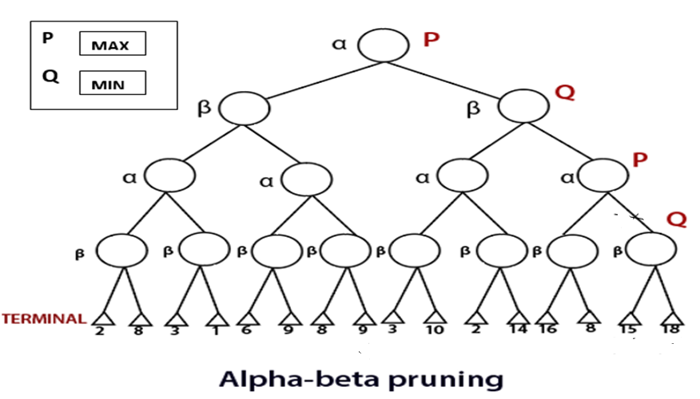
α – β Pruning
P and Q are two players.
P be the player who will try to win the game by maximizing its winning chances.
Q is the player who will try to minimize P’s winning chances.
α will represent the value for P(Maximum).
β will represent the value for Q(Minimum).

Slide 28
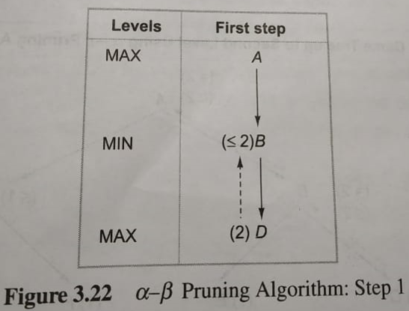
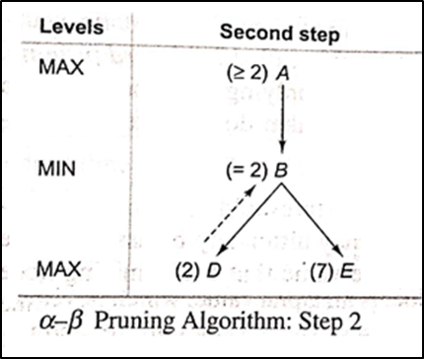
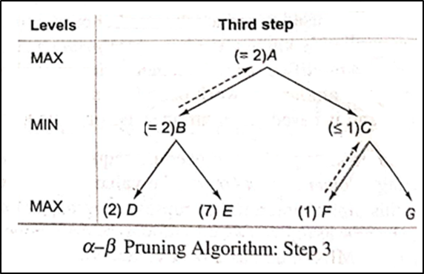
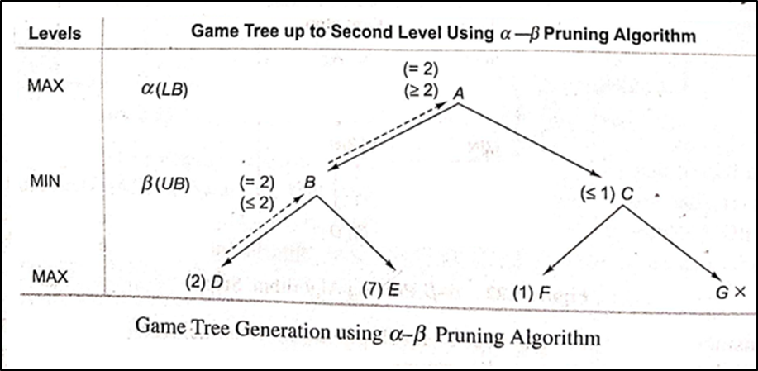
Alpha – Beta Pruning
Systematic Construction of game tree and propagation of α and β values using Alpha – Beta Pruning.

Slide 29
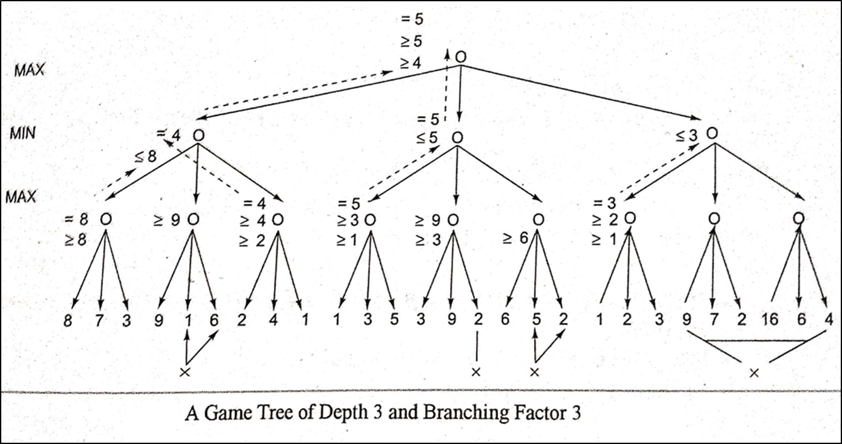
Alpha – Beta Pruning

Slide 30
Example
A
B
I
C
F
J
M
D
E
G
H
K
L
N
O

Slide 31
MINIMAX Algorithm using α – β Pruning
MINIMAX- αβ(Pos, Depth, Player, Alpha, Beta) {
If DEPTH(Pos, Depth) then
return ( { Val=EVAL(Pos, Depth), Path= Nil } )
Else {
SUCC_List = GEN(Pos)
If SUCC_List = Nil then
return ( { Val=EVAL(Pos, Depth), Path= Nil } )
Else {
For each SUCC ∈ SUCC_List Do {
SUCC_Result = MINIMAX - αβ (SUCC, Depth + 1, – Player, – Beta, – Alpha )
New_Value = – Val of SUCC_Result
If NEW_Value > Beta then {
Beta = NEW_Value
Best_Path = Add(SUCC, Path of SUCC_Result)
}
if Beta ≤ Alpha then return Do ({ Val=Beta, Path = Best_Path } )
}
Return ({Val=Best_Val, Path = Best_Path})
}
}
}

Slide 32
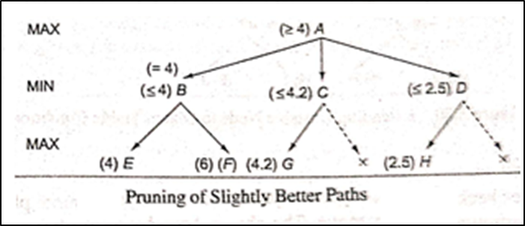
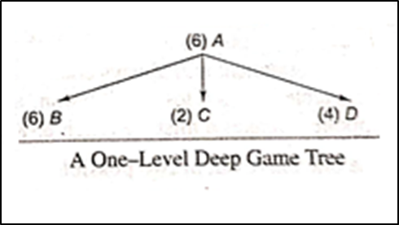
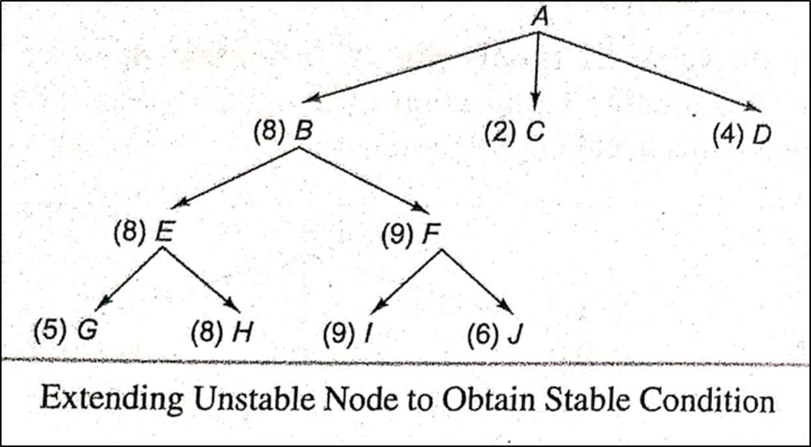
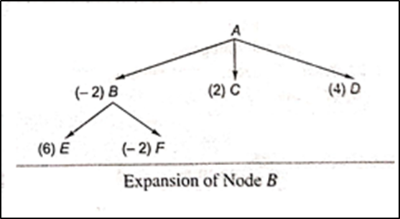
Alpha Beta Pruning
Refinements in α-β Pruning
Pruning of slightly better path
Waiting for Quiescence
Secondary search
Alternative to α-β Pruning MINIMAX Procedure
Iterative Deepening

Slide 33
Thank You

